Slide 1
Power point presentation on FOOD ODERING WEBSITE
Submitted by:_
Submitted to:-
VARUN MALETHA
1813051047
CE 6 sem
NIDHI CHAWLA
(LECTURER, RIT)

Slide 2
FOOD ODERING WEBSITE
The project “Online E-Commerce Services for Multilevel Products” is an application to automate the process of storing records regarding various products, Product categories and their sub-categories. The web-based and mobile based application is design to fulfil the marketing needs of various companies that deals with multilevel products by maintaining the required reports of various products, Product categories and their sub-categories on time. This Application will also help clients/user to and sort products according to their requirements.
In this website , anyone can view food items and order them online without going to anywhere means from home for their comfortable In this .People can do cash on delivery.

Slide 3
HARDWARE AND SOFTWARE TO BE USED
HARDWARE USED: -
RAM – 2GB
Processor - Intel(R) Core (TM) i5-3360M CPU @ 2.80GHz 2.80 GHz
SOFTWARE USED: -
Window 10 pro
Visual Studio Code
Xampp Control Panel
LANGUAGES USED: -
FrontEnd:- HTML CSS JAVASCRIPT
BackEnd:- PHP My SQL

Slide 4

GUI DESIGN

Slide 5
AUTHENTICATION

Slide 6
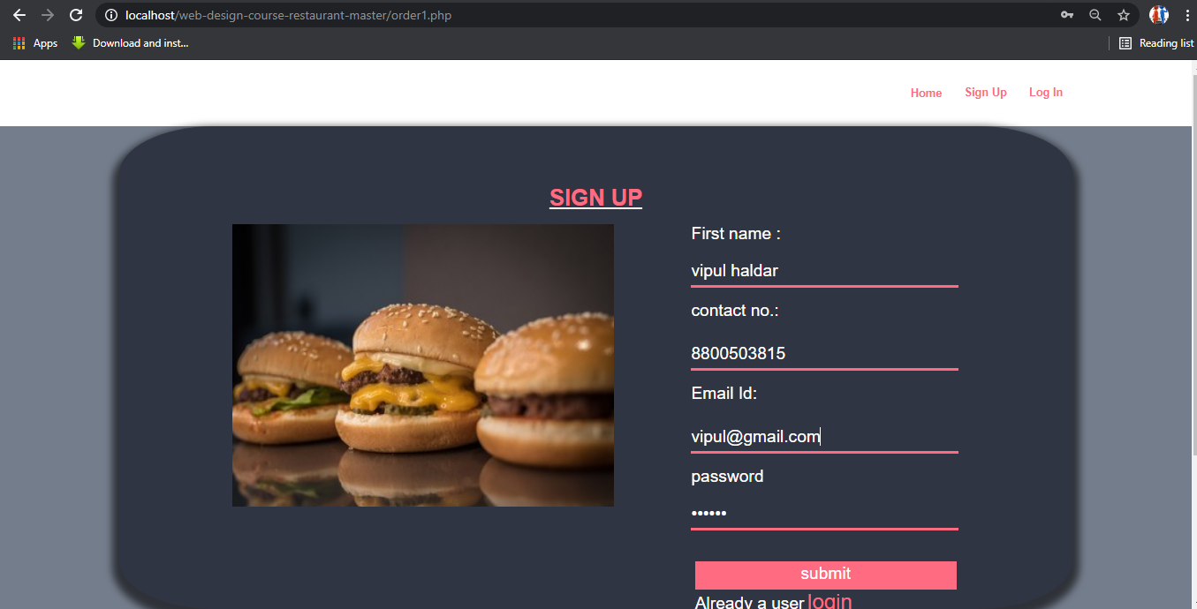

Slide 7
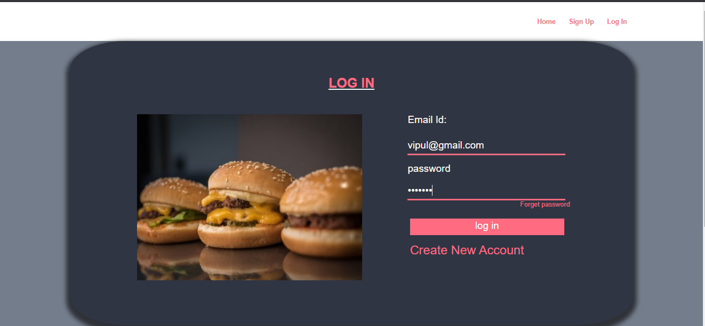

Slide 8
FORGET PASSWORD

Slide 9
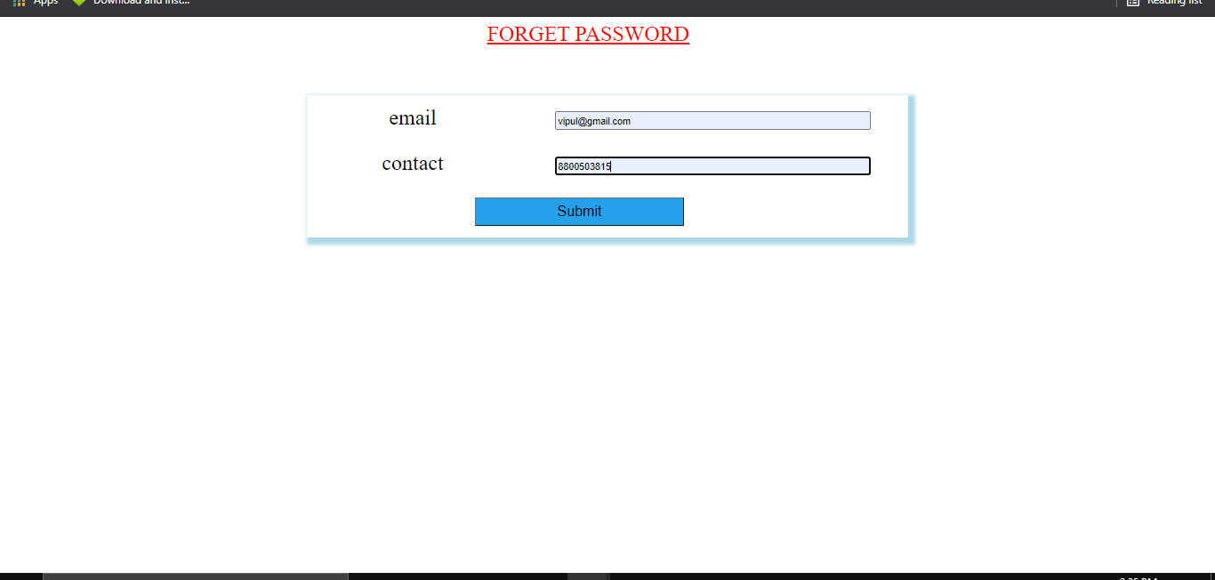
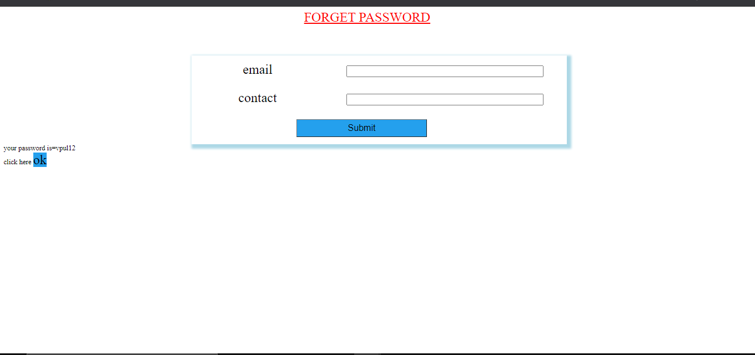

Slide 10
HOME PAGE

Slide 11
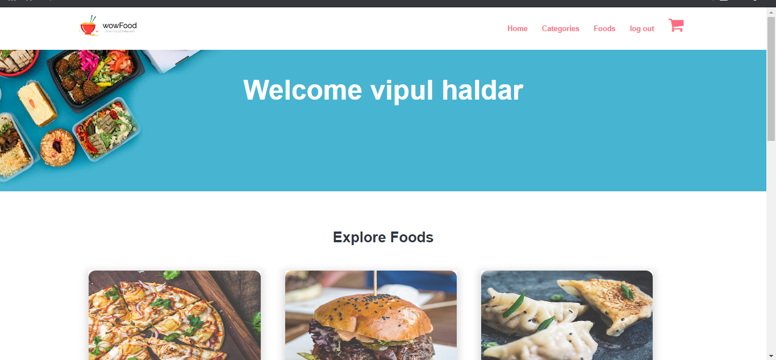

Slide 12
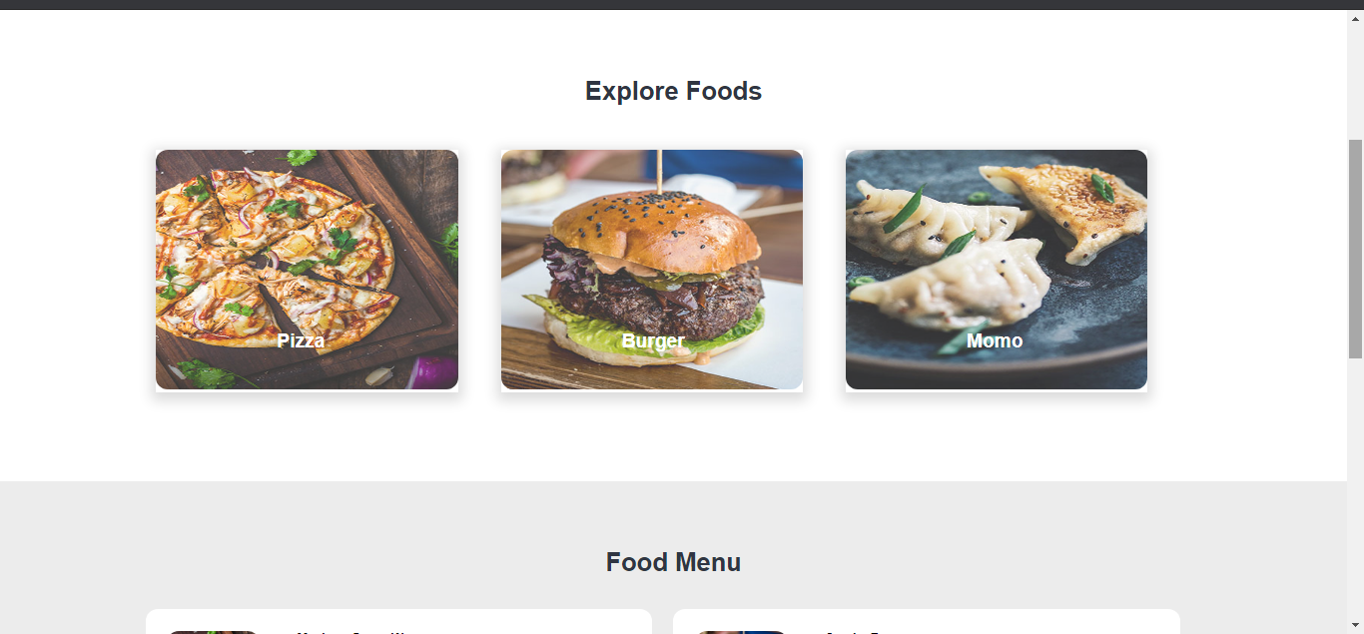

Slide 13
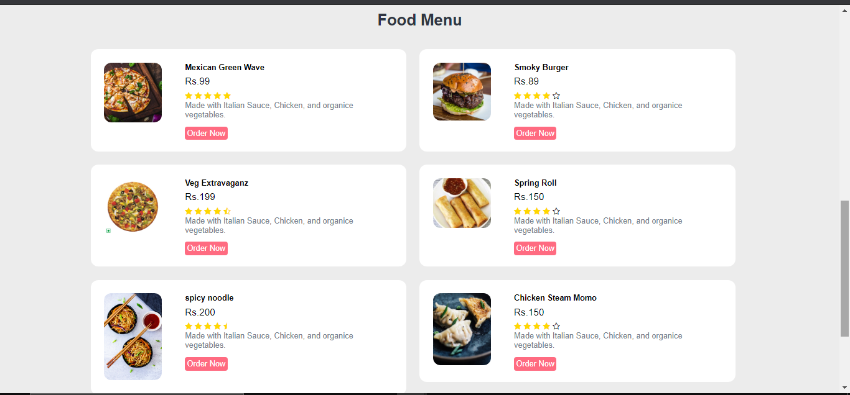
FOOD MENU

Slide 14
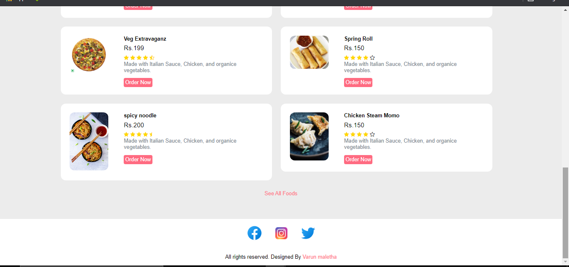
FOOTER

Slide 15
CATEGORIES

Slide 16
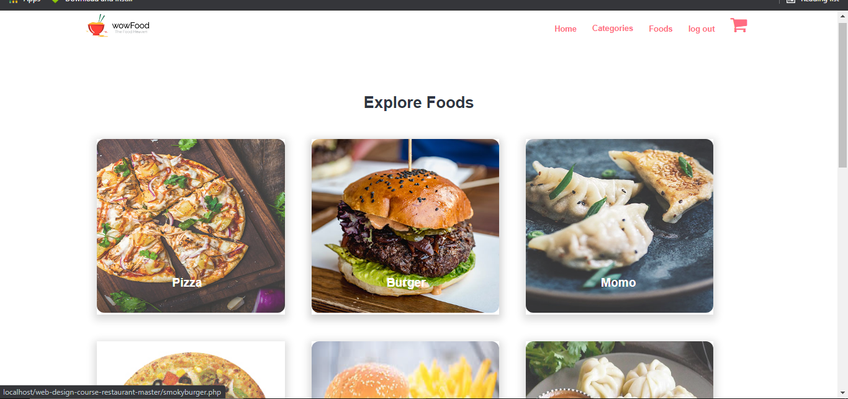

Slide 17
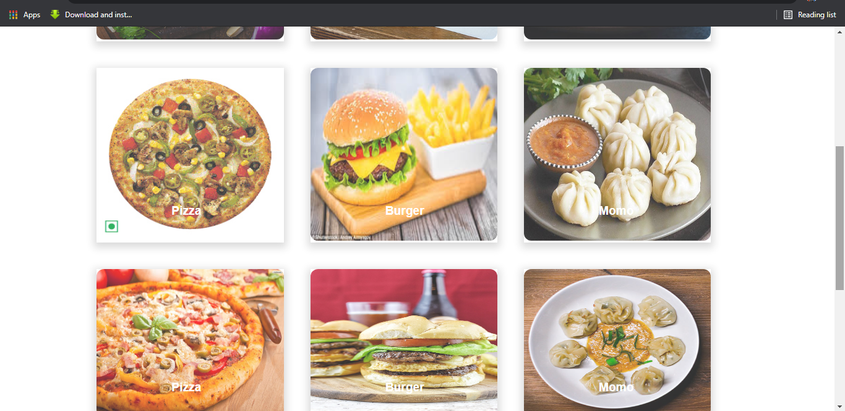

Slide 18
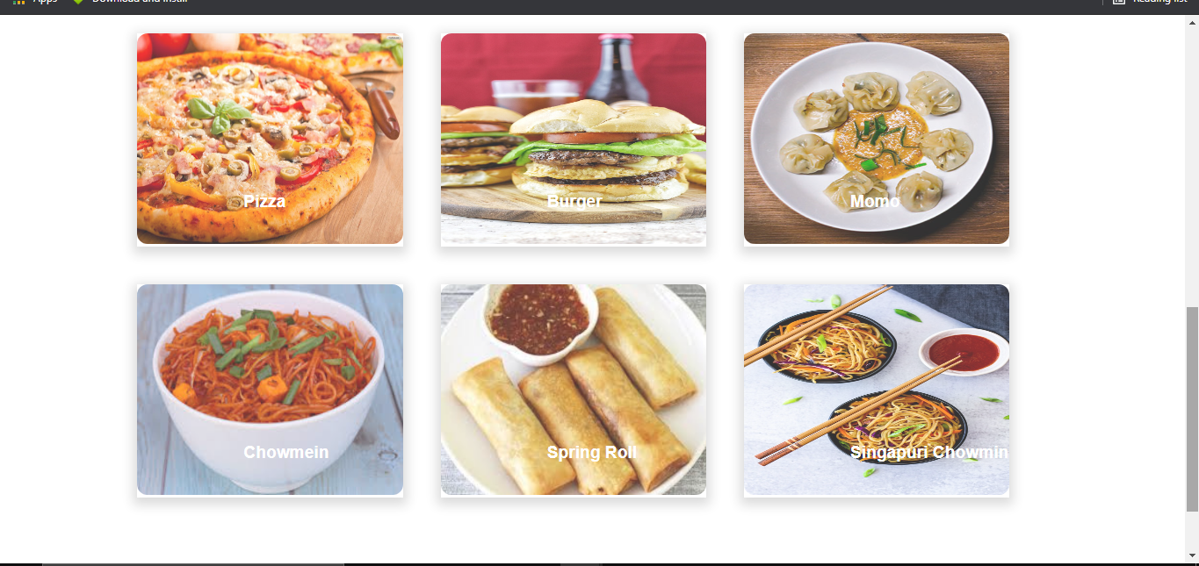

Slide 19
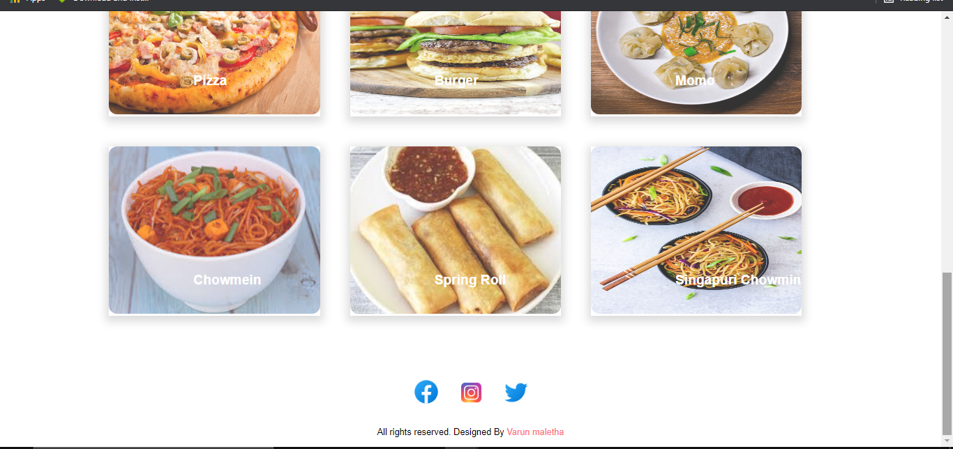

Slide 20
FOOD DETAIL PAGE

Slide 21
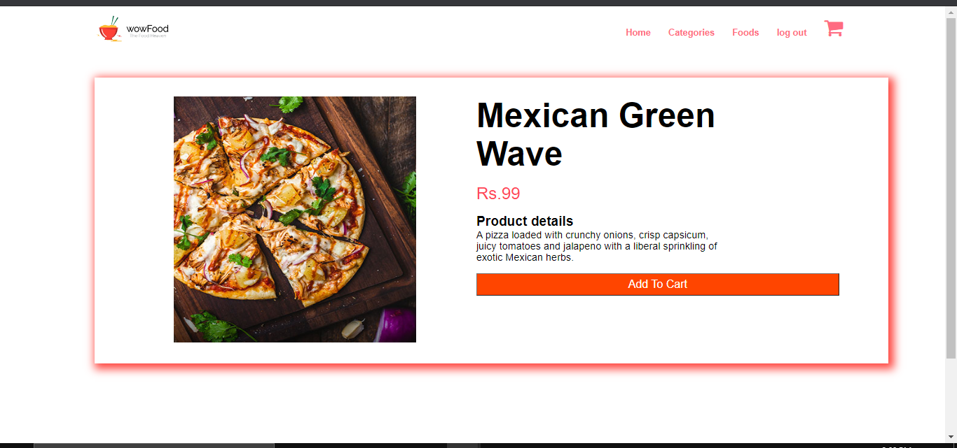

Slide 22
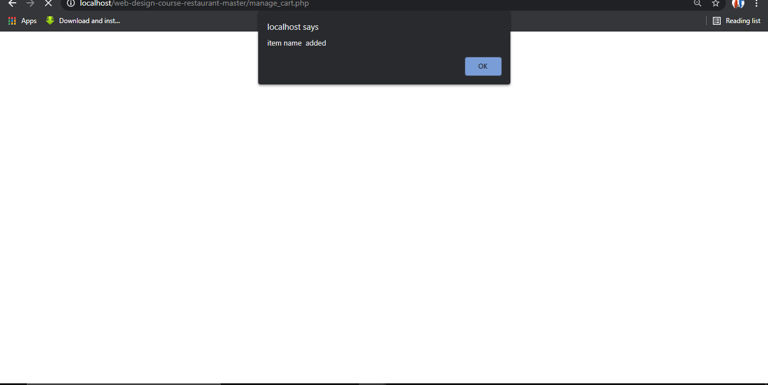

Slide 23
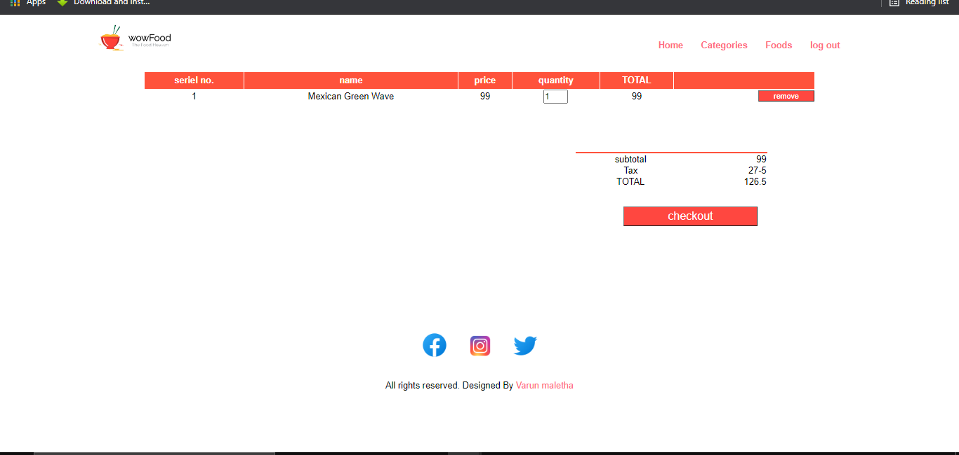
CART
CLICK HERE

Slide 24
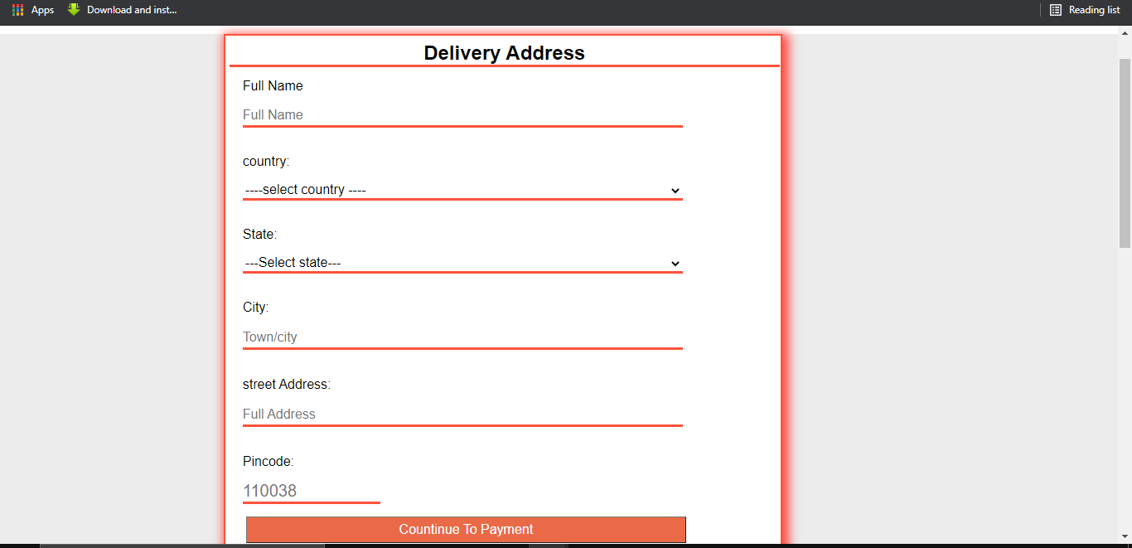
ADDRESS PAGE

Slide 25

DATABASE DESIGN

Slide 26
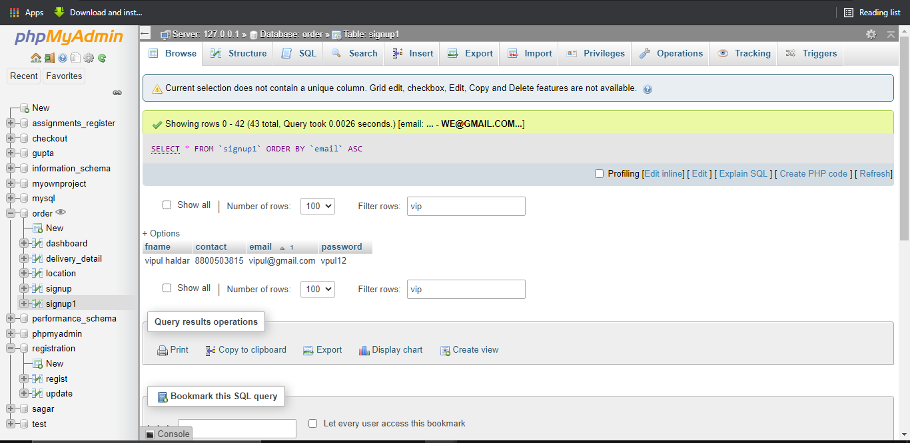
REGISTRATION PAGE

Slide 27
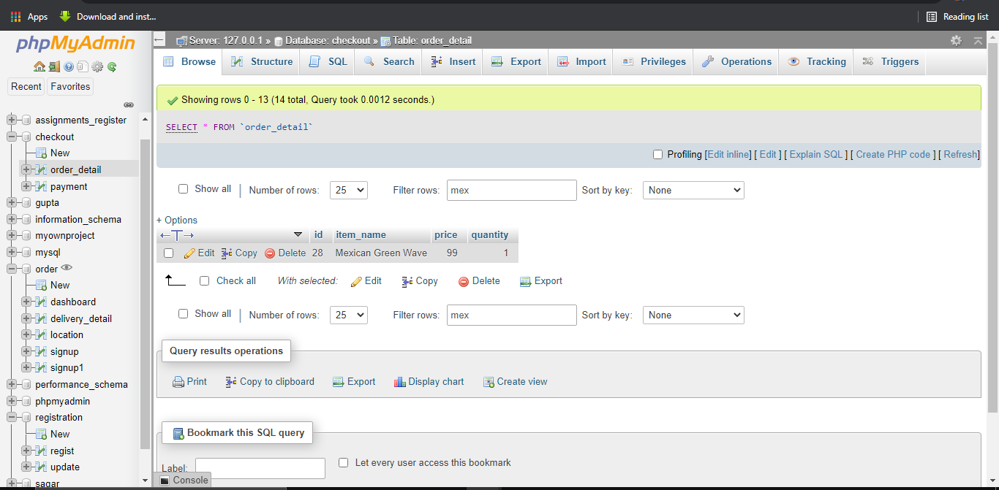
ITEM ADDED ON CART

Slide 28
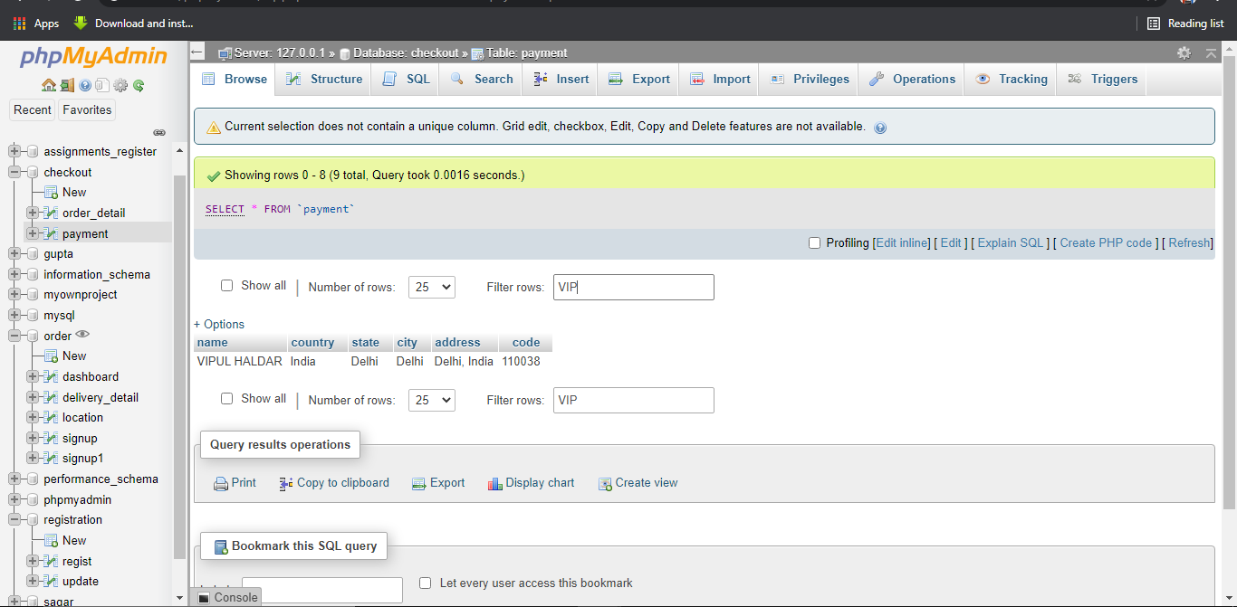
DELIVERY ADDRESS

Slide 29

Thank you

